Slide 1
PYTHON REINFORSEMENT PROJECT
ARUN BALAJE
DA & DS AUG B

Slide 2
ANALYSIS
* Data understanding
* Data cleaning
* Handling missing values
* Outliers
* Data visualization

Slide 3
Introduction
The project focuses on Exploratory Data Analysis (EDA) of Housing to understand the key factors influencing pricing.

Slide 4
Data Understanding
First in data understanding we need to import the CSV file.
The Dataset (Housing) contain date, price, bedrooms, bathrooms, sqft_living, sqft_lot,
floors, waterfront, view, condition, sqft_above,
sqft_basement, yr_built, yr_renovated, street, city,
statezip, country.

Slide 5
Data Cleaning
* Handling Missing Values
* Data type conversion
* Checking outliers

Slide 6
Handling Missing values
* Isnull () function is used to find missing values in dataset.
* Unique () function and replace the unique values.
* Mean and Median is used to fill the missing values in numerical columns.

Slide 7
Converting Datatype
Astype( int, float) is used change the datatype into int or float.

Slide 8
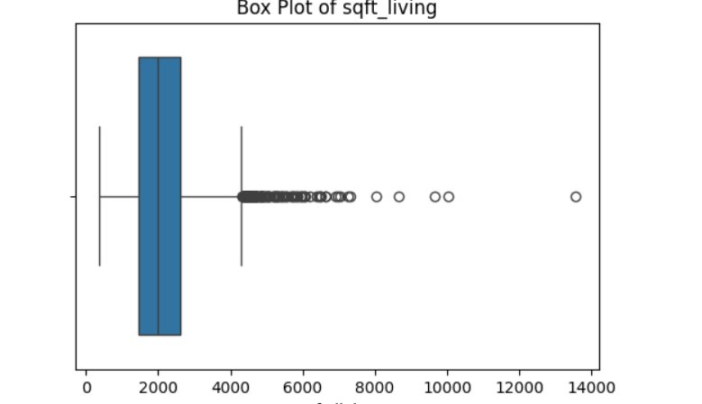
Checking Outliers
Outliers are unusual values that don’t fit the general pattern of the data

Slide 9
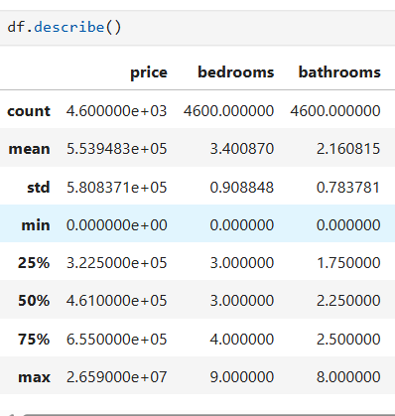
Descriptive Analysis

Slide 10
RECOMMENDATION
Premium property has a waterfront have major price premium.
Investing in renovations or repairs to achieve a higher sale price.
Properties that most influence the sales price is square feet.

